Slide 1
Class 10 Social Science History
Image related questions Of
The Rise of Nationalism in Europe

Slide 2
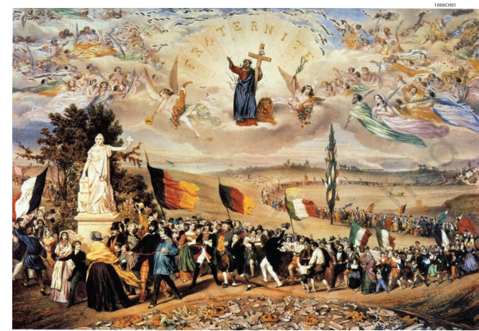
Q. What is the theme of this figure?
Ans. The Dream of Worldwide Democratic and Social Republics – The Pact Between Nations

Slide 3
Q. Who painted and in which year?
Ans. Frédéric Sorrieu, 1848

Slide 4
Q. What does the fig depict?
Ans. The pic shows the peoples of Europe and America – men and women of all ages and social classes – marching in a long train, and offering homage to the statue of Liberty as they pass by it.

Slide 5
Q. Describe the above fig?
Ans. Artists of the time of the French Revolution personified Liberty as a female figure – here you can recognize the torch of Enlightenment she bears in one hand and the Charter of the Rights of Man in the other.

Slide 6
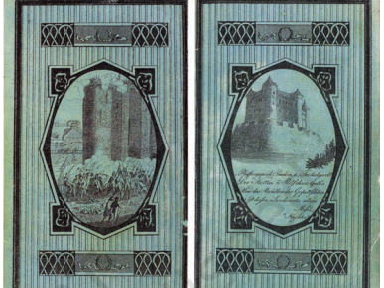
What this fig depicts?
It is the cover of a German almanac ( a calendar with information ) designed by the journalist Andreas Rebmann in 1798.
Rebmann lived in the city of Mainz and was a member of a German Jacobin group.

Slide 7
What is the basic difference in these fig?
The image of the French Bastille being stormed by the revolutionary crowd has been placed next to a similar fortress meant to represent the bastion of despotic rule in the German province of Kassel.

Slide 8
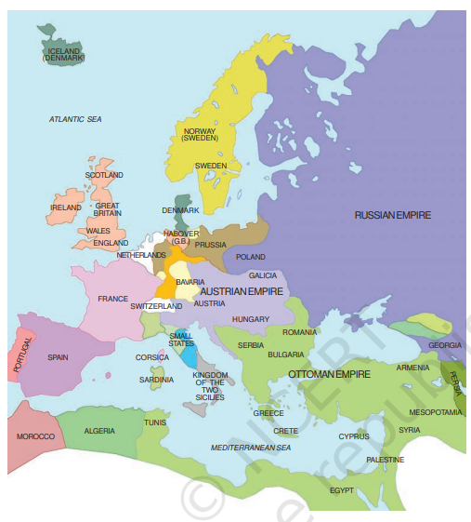
Q. What does the fig shows?
Ans. Europe after the Congress of Vienna, 1815.

Slide 9
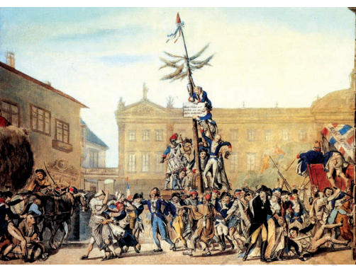
Q. What the pic above tells us.
Ans. The Planting of Tree of Liberty in Zweibrücken, Germany.

Slide 10
Who painted this fig?
The German painter Karl Kaspar Fritz.

Slide 11
Q. In this fig which soldiers are declared as oppressors?
Ans. French

Slide 12
Q.What does the plaque read in the above fig?
Ans. The plaque being affixed to the Tree of Liberty carries a German inscription which in translation reads: ‘Take freedom and equality from us, the model of humanity.’

Slide 13
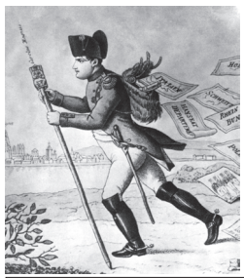
Q. Who is represented as postman in the fig?
Ans. Napoleon here is represented as a postman on his way back to France after he lost the battle of Leipzig in 1813.

Slide 14
Q. What does the letter dropping of his bags shows?
Ans. Each letter dropping out of his bag bears the names of the territories he lost.

Slide 15
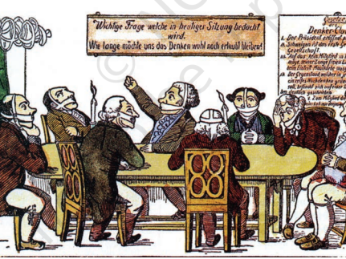
Q. What does this fig represents?
Ans. It represents The Club of Thinkers.

Slide 16
Q. What is the caricaturist trying to depict?
Ans. Silence is the first commandment of this learned society.

Slide 17
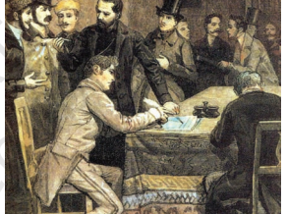
Q. What does the fig depict?
Ans. Giuseppe Mazzini and the founding of Young Europe in Berne 1833.

Slide 18
Q. Who printed the above fig?
Ans. Giacomo Mantegazza

Slide 19
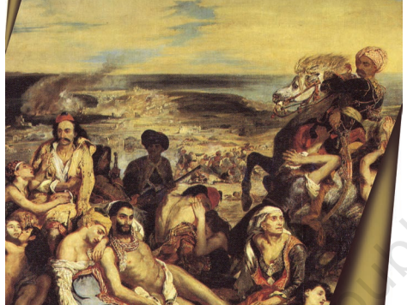
Q. What does the pic depicts?
Ans. The pic depicts an incident in which 20,000 Greeks were said to have been killed by Turks on the island of Chios.

Slide 20
Q. Who is the painter of this fig which shows the massacre at Chios?
Ans. Eugene Delacroix, 1824. The French painter Delacroix was one of the most important French Romantic painters.

Slide 21
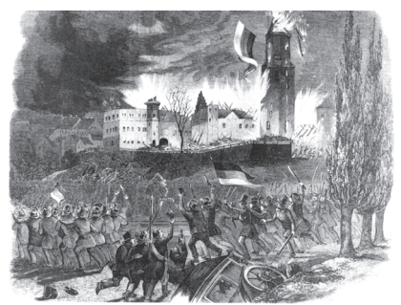
Q. What does the above pic depicts?
Ans. Peasants’ uprising, 1848

Slide 22
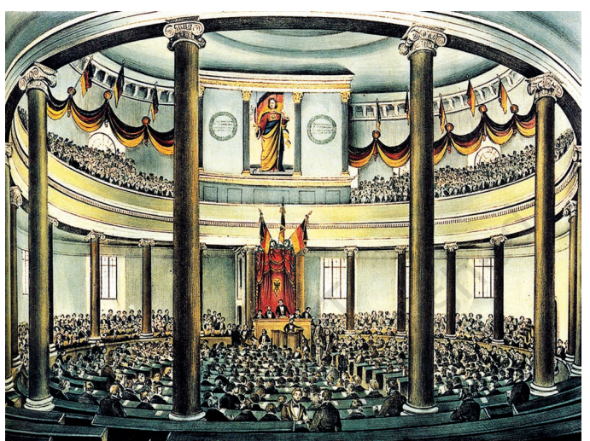
Q. What does the pic above shows?
A. The Frankfurt parliament in the Church of St Paul.

Slide 23
Q. Who in the above pic is shown in the upper left gallery?
Ans. Women, they were admitted only as observers to stand in the visitors’ gallery.

Slide 24
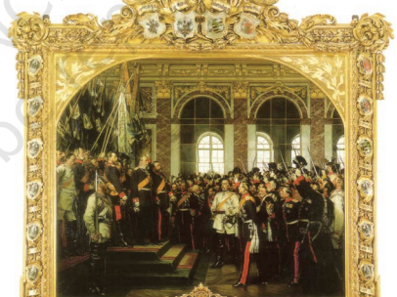
Q. What does the fig depicts?
Ans. The proclamation of the German empire in the Hall of Mirrors at Versailles.

Slide 25
Q. Which three prominent figures are shown in the above pic?
Kaiser William I
General Von Roon
Otto von Bismarck

Slide 26
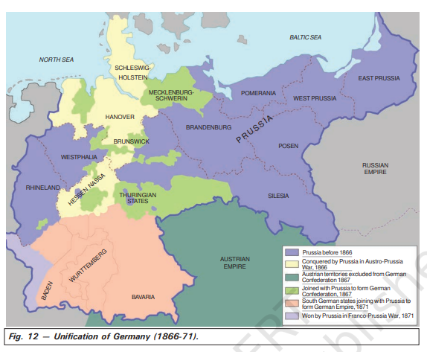
Q. What does the fig shows?
Ans. Unification of Germany (1866-71).

Slide 27
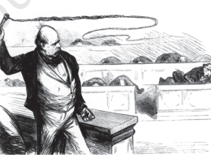
Q. What does the above Caricature depicts?
Ans. It is the Caricature of Otto von Bismarck in the German reichstag (parliament), from Figaro, Vienna, 5 March 1870.

Slide 28
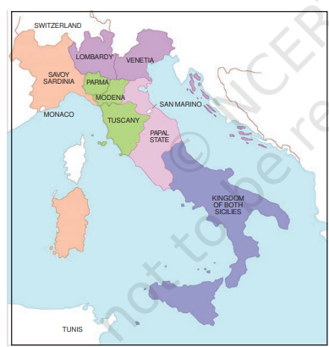
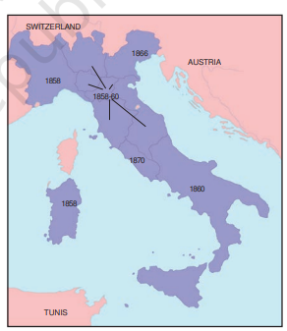
Q. What is the basic difference between this two fig?
This fig shows Italian states before unification, 1858.
This fig shows Italy after Unification

Slide 29
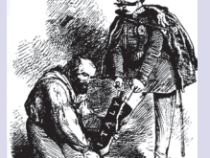
Q. What does this fig depicts?
Ans. Garibaldi helping King Victor Emmanuel II of Sardinia-Piedmont to pull on the boot named ‘Italy’. It was drawn in the year 1859.

Slide 30
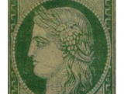
Q. Who is shown in this figure?
Ans. This figure is of Marianne representing the Republic of France. It is a postage stamp of 1850.

Slide 31
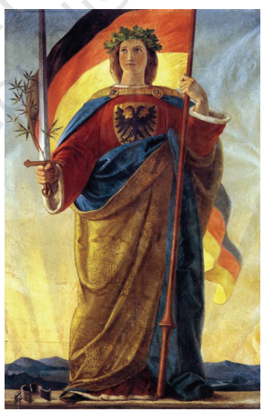
Q. Who is shown in this figure? Who built this fig? Describe this fig.
Ans. Germania. The artist prepared this painting of Germania on a cotton banner, as it was meant to hang from the ceiling of the Church of St Paul where the Frankfurt parliament was convened in March 1848. It was Built by Philip Veit in 1848.

Slide 32
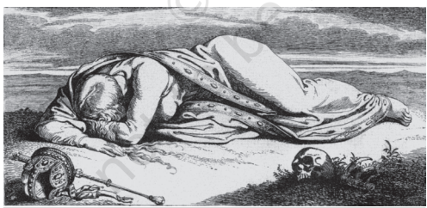
Q. What does the fig depict?
Ans. The fallen Germania. It was made by Julius Hubner in 1850

Slide 33
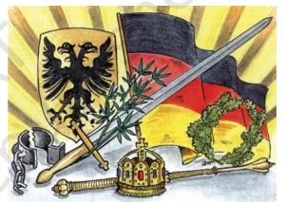
Q. Describe the attributes in this image.
Broken chains ----------------------------Being freed
Breastplate with eagle ------------------Symbol of the German empire – strength
Crown of oak leaves -------------------------Heroism
Sword -------------------------------Readiness to fight
Olive branch around the sword ----------------------Willingness to make peace
Black, red and gold tricolour ---------------------------Flag of the liberal-nationalists in 1848, banned by the Dukes of the German states
Rays of the rising sun --------------------------Beginning of a new era

Slide 34
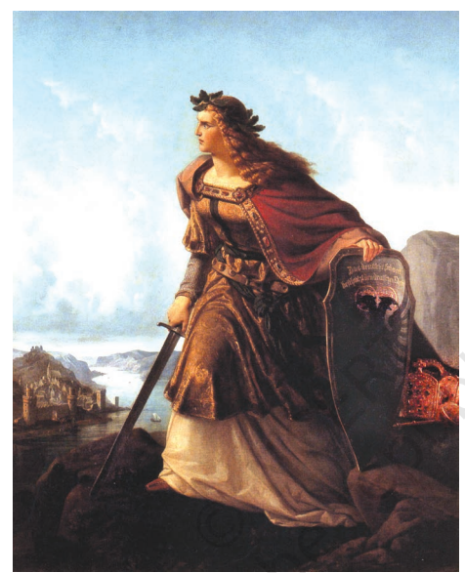
Q. What does the fig depicts? What does the inscription in the sword reads?
Ans. Germania guarding the Rhine. The inscription on Germania’s sword reads: ‘The German sword protects the German Rhine.’ This painting was made by Lorenz Clasen In 1860.

Slide 35
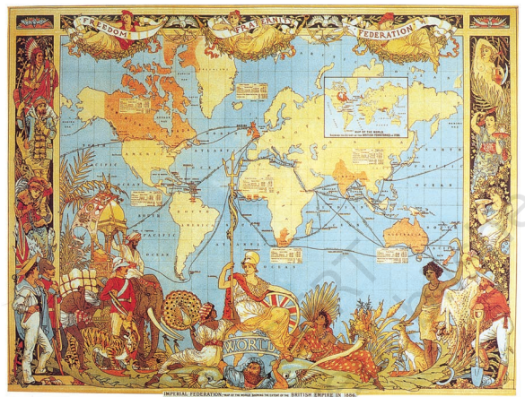
Q. What does the image depicts?
Ans. A map celebrating the British Empire.

Slide 36
Q. Describe the above Image.
Ans. At the top, angels are shown carrying the banner of freedom. In the foreground, Britannia — the symbol of the British nation — is triumphantly sitting over the globe. The colonies are represented through images of tigers, elephants, forests and primitive people. The domination of the world is shown as the basis of Britain’s national pride.

