Slide 1
From the Rulers to the Ruled: Types of Governments
Chapter – 9 by Samrendra Kumar TGT- SST
JNV East Singhbhum, Jharkhand
Visit:- https://jnvteacher.in

Slide 2
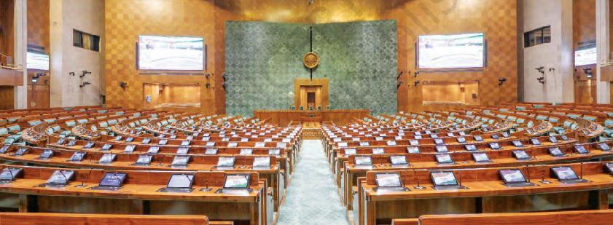
The Indian Parliament

Slide 3
Kauṭilya in Arthaśhāstra
A ruler’s duties in the internal administration of the country are three-fold: rakṣha (protection of the state from external aggression), pālana (maintenance of law and order within the state), and yogakṣhema (safeguarding the welfare of the people).

Slide 4
Triger Questions
1. What are the different types of government?
2. Where do governments get their power from?
3. How does a country’s government interact with the people?
4. Why does democracy matter?

Slide 5
What are the Functions of the Government?
maintaining law and order in society;
ensuring peace, stability, and security for the people;
managing relationships with other countries;
taking care of national defence;
delivering essential goods and services (education, healthcare, infrastructure);
managing the economy and economic activities;
working for the welfare and improving people’s lives.

Slide 6
Democratic Form of Government
we learned that India has a democratic form of government. Like India, many countries have a democratic government; but some countries have other forms of governments.
Even all democratic governments are not exactly the same. How they differ from each other, and how they function.

Slide 7
What is Democracy?
‘Democracy’ is best understood as ‘rule of the people.’
This means that the source of power and authority in a democracy are the people of the country.

Slide 8
A school example
A school is full of activities and things that must be done.
For example, there are timetables to be made and followed, sports activities to be organized, food to be served during lunch time, utensils to be cleaned, speakers to be decided for the morning assembly.
With so many things to be done, the Head Teacher realized that a Student Committee should be appointed so that students can be part of making the relevant rules, then help in implementation of the rules, and ensure that the rules are being followed.
The question before the Head Teacher was — who will be part of the committee?

Slide 9
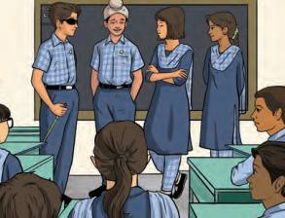
.
She proposed that it would be good if some students can take responsibility for these tasks. A student committee should be formed. Hearing this, the students got excited and started arguing.
Naghma: Students in Grade 12 are the most senior; we will take care of everything.
Shobha: But you will finish school in a few months. The students in Grade 11
should take care of everything.
Gurpreet: If the students of only one grade will take care of everything, then how will they know about the problems that other grades face?

Slide 10
Representative
Representative: A person who is chosen to act or make decisions on behalf of another person or group of people.

Slide 11
In this exciting situation, the students finally came to three options:
Everyone in the school becomes part of the committee and takes responsibility.
The Head Teacher chooses the students herself for the committee.
The students choose their representatives through voting, and the chosen representatives become the members of the committee.
Which of the three methods do you think is most effective? Why?
The 3rd approach is a democratic way to choose representatives and form a committee.

Slide 12
The 3rd approach is a democratic way to choose representatives and form a committee.
This representative will serve on the committee, meaning that the student committee will consist of representatives from each grade.

Slide 13
Functions of Government
A government must create necessary rules, implement them, and ensure that everyone follows these rules. These three responsibilities are known as the functions of government.

Slide 14
Legislative function
The creation of rules is called the legislative function; these rules serve as the framework for running the country.

Slide 15
Executive function
The implementation of these rules and the administration of the country according to them is known as the executive function.

Slide 16
Judicial function
Ensuring that the rules are followed is referred to as the judicial function.

Slide 17
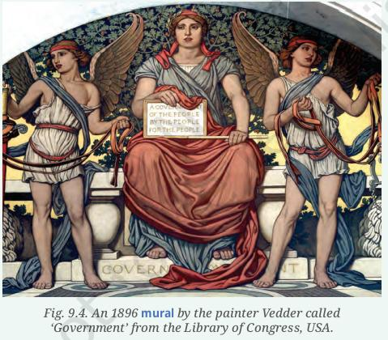
Mural: A large painting or artwork created directly on a wall or a ceiling.

Slide 18
Abraham Lincoln
Abraham Lincoln, a U.S. president in the late 19th century, described democracy as a ‘government of the people, by the people, for the people’, a phrase still widely used today.

Slide 19
What Makes Governments Different?
The government of any country evolves over time. Since countries have their own history, culture, and aspirations, it is natural that governments of different countries are different.

Slide 20
Key differences between governments
Who gets to decide that ‘this is the government’?
How is the government formed?
What are the different parts of the government and what do they do?

Slide 21
Who gets to decide that ‘this is the government’?
In India, it is the people of the country who decide and are the source of authority, while in a theocracy, the source of authority is religious beliefs and the head of a religious institution.

Slide 22
How is the government formed?
In a democracy, a government is formed usually through some kind of election.
While in kingdoms which have kings or queens, usually someone from within the family continues to rule and decide how the government will be set up.

Slide 23
What are the different parts of the government and what do they do?
In India we have 3 parts
Legislative,
Executive,
Judiciary.
How the government will work can be written down in a book of fundamental rules of the country, called the ‘constitution’ in a Democracy.
Or it can be decided by the king or queen, as it happens in ‘monarchies’.

Slide 24
What is the government working for? What goals is it trying to achieve?
The government of India, are designed to work towards equality and prosperity for all.
While some other governments may be designed only for the prosperity of some families or groups.

Slide 25
Different forms of democratic governments.
Direct democracy
Representative democracy

Slide 26
Direct democracy
This is a form of democracy where all the citizens of a country are directly responsible for all the rules, regulations and functions. Eg, Switzerland.
The limitation of this form of government is that it is very hard to carry out in practice, particularly in larger countries.

Slide 27
Representative democracy
This is the form of democratic government in which the people elect their representatives through universal adult franchise, just like in India.
In this form of democracy, the people do not directly govern, but the government is always accountable to the people.

Slide 28
Elections are an integral part of representative democracy.
Elections happen in regular and fixed intervals of time. In India we have general elections every five years, while in the United States of America they occur every four years.

Slide 29
Accountability
Accountability in democracy means that the government is answerable to the people who have elected them.

Slide 30
Fundamental principles of democracy
Equality
Freedom
Representative participation
Universal adult franchise
Fundamental rights
Independent judiciary

Slide 31
Universal adult franchise
The right to vote in elections to all adults.
18 years

Slide 32
Equality
Equality in a democracy means that every person has the right to be treated equally.
Equal access to facilities like education and health, and that everyone is equal before the law.

Slide 33
Freedom
Freedom in democracy means that citizens have the right to make their own choices and express their opinions.

Slide 34
Representative participation
It means that every person has a right to choose and elect their representatives.
This is done through the process of elections.
Elected representatives become a part of the legislature.

Slide 35
Fundamental rights
Fundamental rights of a citizen, such as
Right to equality,
Right to freedom of speech and expression,
Right against exploitation
Are all provided and protected in a democracy.

Slide 36
Independent judiciary
Independent judiciary ensures that every citizen’s fundamental rights are protected, and that laws are followed by the citizens and also by all the parts of the government.

Slide 37
Not all democracies are able to put them in practice.
India provided universal adult franchise (meaning the right to vote in elections to all adults) from the very beginning of the Indian republic in 1950; on the other hand, in Switzerland, women got the right to vote only in 1971.

Slide 38
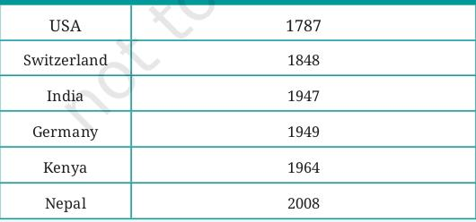
Year when democracy was established

Slide 39
There are two Forms of representative democracy
Parliamentary democracy
Presidential democracy

Slide 40
Parliamentary democracy
The members of the executive are also part of the legislature.
For example, in India, the prime minister and the council of ministers are also members of the parliament.
The council of ministers are accountable to the legislature and continue working as long as they have the confidence of the legislature. In India, the council of ministers can continue working while they have confidence of the Lok Sabha.
In this form of government, people elect the legislature but not the executive. Selected members of the legislature become ministers.

Slide 41
Presidential democracy
The executive works independently of the legislature. The president is elected by the people.
The president does not need to have the confidence of the legislature for his / her position.
In some countries like India, states within the country such as Rajasthan or Kerala have their own governments, but they are not completely independent. They are still governed by a larger national government, the Union Government of India.

Slide 42
Organ of the government
Executive
Legislature
Judiciary

Slide 43
Executive
The executive is the organ of the government which is responsible for implementing the law. But the process of its election is different in different countries.

Slide 44
Legislature
Legislature: The legislature is the body of the government which is responsible for making laws. It is known by different names in different countries. In India, it is called Parliament; in the USA, it is called Congress. In most democracies, it has two houses, the Upper House and the Lower House.

Slide 45
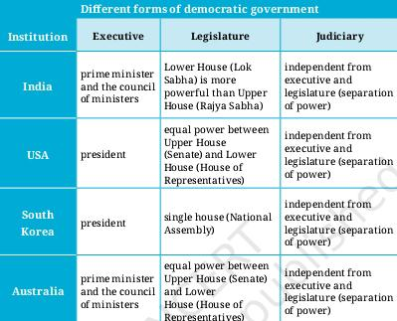
Different forms of democratic government

Slide 46
Two houses of the Parliament
Upper House
Lower House
In India, the Lower House is called the Lok Sabha, and the Upper House is called the Rajya Sabha.

Slide 47
Separation of Power
It means that the three organs of the government—Legislature, Executive, and Judiciary—work independently and do not interfere in each other’s functions.

Slide 48
Republic
A republic is a form of government in which the head of state is elected and is not a hereditary monarch.

Slide 49
At least two of India’s ancient mahājanapadas practiced Republic.
In the Vajji (or Vṛiji) mahājanapada, the Lichchhavi clan, in particular, practised collective decision-making, and leaders were chosen based on merit rather than birth.
Key positions were filled through elections, and representatives from various clans met regularly to address issues and develop solutions to ensure the people’s welfare.

Slide 50
Uttaramerur inscriptions
The 10th century CE in Tamil Nadu, which provide us with details about the election of members to the village sabha (local administrative body).
We learn about the election process, including sealed ballot boxes, qualifications of members, their duties, and also the conditions that could lead to their dismissal.

Slide 51
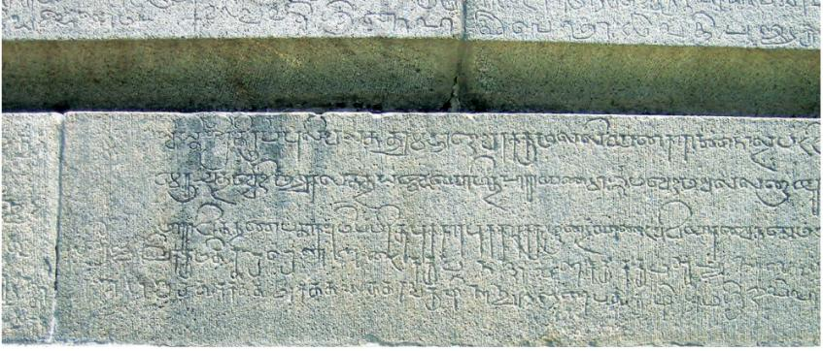
Chola period inscriptions on the walls of Vaikuntha Perumal temple, Uttaramerur, Tamil Nadu.

Slide 52
Republics in other parts of the world
In the 5th and 4th centuries BCE, Rome and Greece had republics. In some regions of Greece, free men could vote, but women, workers and slaves could not.
Other areas had a system where only a small, privileged group could vote or make decisions.

Slide 53
Slave
Slave: A person who is forced to work for and obey another and is considered to be their property.

Slide 54
Other Forms of Government
1. Monarchy
2. Monarchies today
A) Absolute monarchy
B) Constitutional monarchy
3. Theocracy
4. Dictatorship
5. Oligarchy

Slide 55
Monarchy
As empires were built and expanded across India, kings began to gain immense power. Yet, they relied on a council of ministers and a network of officials to help them govern the empire.
In many cases, the king also sought the advice of learnt scholars on matters related to dharma. Of course, there were also examples of kings who used their power to subjugate their people.

Slide 56
Rajadharma
However, in many parts of India, the power of the raja was neither absolute nor beyond question.
The king was expected to make decisions while staying within the limits of rājadharma; this meant ruling according to dharma and ensuring the welfare of all people.

Slide 57
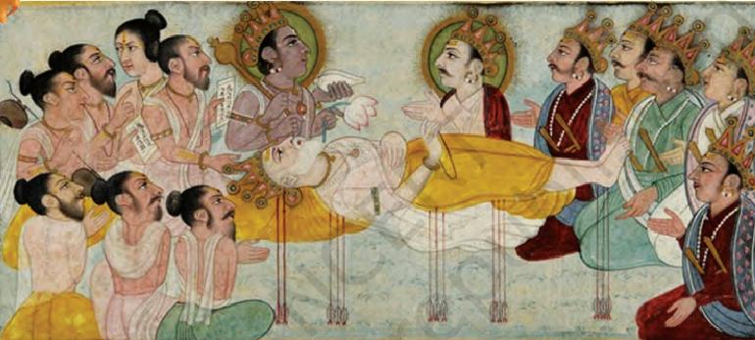
A 17th-century Rajput miniature painting depicting Bhīṣhma lying on a bed of arrows, teaching Yudhiṣṭhira while Kṛiṣhṇa sits at the head, witnessing the moment.

Slide 58
In the Shānti Parva of the Mahābhārata, when Bhīṣhma, the wise elder of the Kuru dynasty, lies on a bed of arrows awaiting his death, he teaches Yudhiṣṭhira, the eldest Pāṇḍava, at great length on good governance, justice, and the moral responsibilities of a raja.
A raja is not just a ruler; the welfare of his people is his highest priority. He must apply the law without bias to ensure fairness and equality.
He must not get attached to power, as it fosters ego and corruption. He must seek guidance from wise advisors to ensure just and well-informed decisions.
The raja must understand that his authority is temporary and bound by dharma.

Slide 59
King Chandrāpīḍa
From Rājataraṅgiṇī by the Kashmiri scholar Kalhaṇa (12th century CE).

Slide 60
Sovereign
Sovereign indicates that the source of power of a country is independent from external influence.

Slide 61
Monarchies today
A monarchy is the type of government that is ruled by a monarch. Kings and queens are called monarchs, who exercise their sovereign power.
Monarchies are usually hereditary; typically, the eldest son of the ruling monarch becomes the next king.

Slide 62
Monarchs
Kings or queens who inherit their position from their family, usually passing it from one generation to the next within the royal family.
Today we have two types of monarchy:
A) Absolute monarchy
B) Constitutional monarchy

Slide 63
Absolute monarchy
The monarch has complete control in the making of laws, ensuring that they are followed, eg Saudi Arabia.
Here the king holds all power and governs according to Islamic law.

Slide 64
Constitutional monarchy
The head of the state is the king or queen, but he or she has only nominal power and the real power of the executive is exercised by the prime minister. The legislative power is exercised by the parliament.
This means that all the laws are made by the elected parliament, and executive power is exercised by the Council of Ministers led by the prime minister.
Eg - United Kingdom or Britain

Slide 65
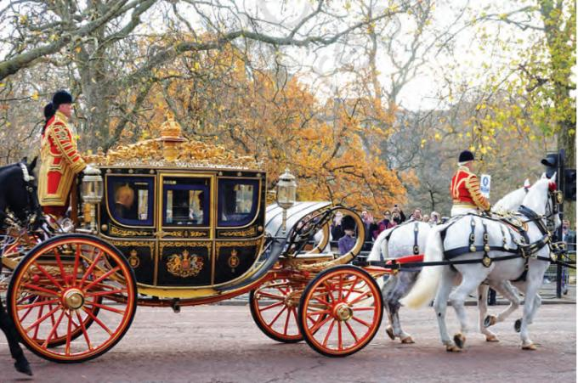
King Charles III in a ceremonial coach during the visit of a foreign dignitary.

Slide 66
Theocracy
A theocracy is a form of government where the country is ruled by the rules of religion and religious leaders.
Eg – Iran, Afghanistan and Vatican City

Slide 67
Theocracy in Iran
Whose full official name is ‘Islamic Republic of Iran’ has a unique political system combining elements of both a theocratic and democratic governance. Their constitution is based on the principles of Islam.
The Supreme Leader, who has the ultimate authority over the legislature, executive and judiciary, is selected by a group of Islamic clerics and his term is for life.
There are also an elected president and a parliament that take care of everyday governance.
The intent of the republic is to establish a society based on Islamic norms.

Slide 68
Dictatorship
A dictatorship is a form of government in which one person, or a small group possesses absolute power — they do not have any limits imposed on them by a constitution or law.
Adolf Hitler (Germany)
Idi Amin (Uganda)

Slide 69
Adolf Hitler
Adolf Hitler was appointed Chancellor of Germany in 1933, he passed laws that gave him full power and eliminated the opposition.
He was now a dictator. Convinced of the superiority of his people, he believed that Germany should rule the world and dominate ‘inferior races’.
He was responsible for the killing of at least six million Jews (this is known as the ‘Holocaust’) as well as hundreds of thousands of Roma and other groups of people. In fact, he was the cause for World War II in the years 1939–1945.

Slide 70
Idi Amin
He was a military dictator in Uganda. He was directly responsible for the merciless killing of thousands of people.
Many Indians whose ancestors had migrated to Uganda a few generations before were forced to flee the country.

Slide 71
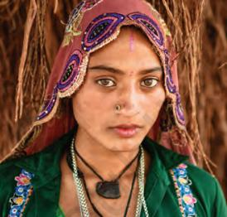
The Roma, or Romani people
The Roma, or Romani people; were originally nomads. Based on their linguistic and cultural characteristics, scholars have determined that they originated in India. They first settled in parts of eastern Europe but have now migrated to several countries of the world.

Slide 72
Story of Shane
Shane lives in North Korea which has a set of defined rules for his everyday living. He is currently serving in compulsory military service in which he is expected to serve in the military till the time government decides. There are also rules about how his hair should be cut and the clothes he should wear.
He cannot access the global internet, and so is unaware of the world outside his own country. The government watches his every action closely and he is also expected to report about anyone who tries breaking any of the defined rules.
One day he met a tourist who asked him, “Why do all of you have the same haircut here?” To this Shane responded, “We all want to explore new styles, but the government decides the way we should keep our hair.”

Slide 73
Oligarchy
It is a type of government where a small, powerful group makes all the important decisions; usually they are wealthy families or influential people.
The word ‘oligarchy’ is of Greek origin, where olígos means a few and árkhō means to rule or command.

Slide 74
Why Democracy Matters
The different types of governments show us that democracy is not the only way in which countries are governed. But in most countries, democracy is considered to be a better form of government than others.

Slide 75
Even democracies have their problems.
Issues such as corruption, wealth disparity, excessive control by a few over democratic institutions, erosion of the judiciary’s independence, manipulation of information channels, and several more, can cause hurdles in achieving the ideals of democracy.

Slide 76
Conclusion
In a democratic government, the people choose their government. The government is accountable for protecting the rights of its people and is responsible for providing basic needs to its citizens.
If the government does not perform its functions properly, the people can change their representatives through elections. This ensures that there is a constant check of what the government does.
Thus, the values and ideals of the government in a democracy should focus on the well-being of all its people.

Slide 77
.
Thank you

